Slide 1

Optimization of 60 GHz three-port Grid Array Antenna (GAA)
ZHAO WEI 17/05/2023
© Copyright National University of Singapore. All Rights Reserved.

Slide 2
Table of Contents
Introduction
GAA Structure
Optimization steps
Optimization performance
Conclusion

Slide 3
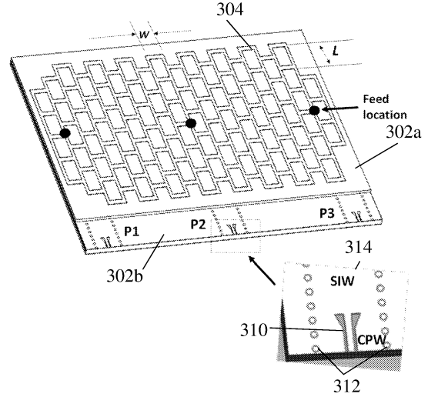
Introduction
01
The GAA was first proposed by Kraus in 1964, and some studies have been studied since then by Nakano and his group [1] and Zhang’s group [2-4]. Sun proposed a three-port GAA in 2020 [5].
Feeding at edge port - producing frequency scanning beams, which enables fast scanning 2D radar imaging applications.
Feeding at center port - working at resonant mode thus producing boresight beams, which enables 3D radar imaging applications.
Fig.1. Cross - sectional view of the GAA proposed by Sun [5]

Slide 4
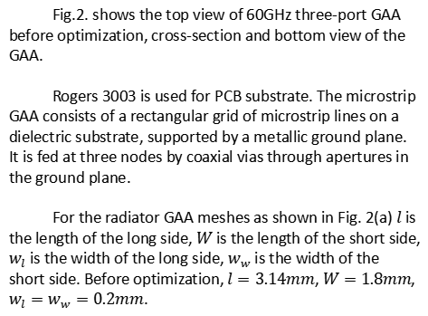
GAA Structure
02
Fig.2. shows the top view of 60GHz three-port GAA before optimization, cross-section and bottom view of the GAA.
Rogers 3003 is used for PCB substrate. The microstrip GAA consists of a rectangular grid of microstrip lines on a dielectric substrate, supported by a metallic ground plane. It is fed at three nodes by coaxial vias through apertures in the ground plane.
For the radiator GAA meshes as shown in Fig. 2(a) $l$ is the length of the long side, $W$ is the length of the short side, $w_{l}$ is the width of the long side, $w_{w}$ is the width of the short side. Before optimization, $l=3.14mm$, $W=1.8mm$, $w_{l}=w_{w}=0.2mm$.
(a)
(b)
(c)
Fig.2. Structure of 60GHz three-port GAA: (a) the top view before optimization, (b) the cross-section, (c) the bottom view.

Slide 5
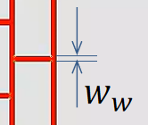


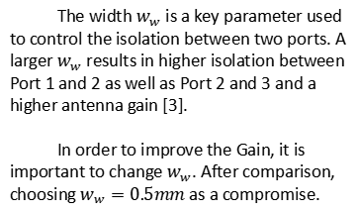
Optimization steps
03
Step 1 – Change the width of short side $w_{w}$.
The width $w_{w}$ is a key parameter used to control the isolation between two ports. A larger $w_{w}$ results in higher isolation between Port 1 and 2 as well as Port 2 and 3 and a higher antenna gain [3].
In order to improve the Gain, it is important to change $w_{w}$. After comparison, choosing $w_{w}=0.5mm$ as a compromise.
Fig.3. Schematic diagram of $w_{w}$.

Slide 6
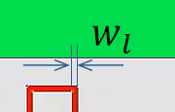


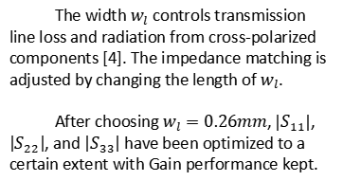
Optimization steps
03
Step 2 – Change the width of long side $w_{l}$.
The width $w_{l}$ controls transmission line loss and radiation from cross-polarized components [4]. The impedance matching is adjusted by changing the length of $w_{l}$.
After choosing $w_{l}=0.26mm$, $\left|S_{11}\right|$, $\left|S_{22}\right|$, and $\left|S_{33}\right|$ have been optimized to a certain extent with Gain performance kept.
Fig.4. Schematic diagram of $w_{l}$.

Slide 7
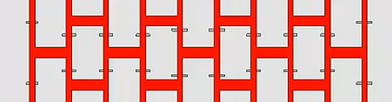
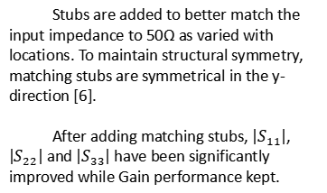
Optimization steps
03
Step 3 – Add matching stubs.
Stubs are added to better match the input impedance to 50Ω as varied with locations. To maintain structural symmetry, matching stubs are symmetrical in the y-direction [6].
After adding matching stubs, $\left|S_{11}\right|$, $\left|S_{22}\right|$ and $\left|S_{33}\right|$ have been significantly improved while Gain performance kept.
Fig.5. Schematic diagram of matching stubs.

Slide 8
Optimization steps
03
(a)
(b)
Fig.6. (a) the top view before optimization, (b) the top view after optimization.
It is noted in the optimization only GAA radiator is changed.

Slide 9
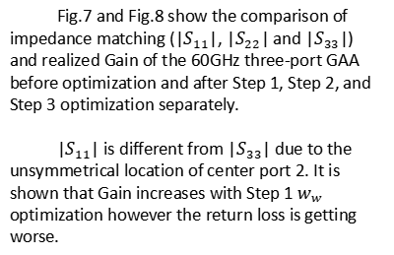
Optimization performance
04
Fig.7 and Fig.8 show the comparison of impedance matching (|$S_{11}$|, |$S_{22}$| and |$S_{33}$|) and realized Gain of the 60GHz three-port GAA before optimization and after Step 1, Step 2, and Step 3 optimization separately.
|$S_{11}$| is different from |$S_{33}$| due to the unsymmetrical location of center port 2. It is shown that Gain increases with Step 1 $w_{w}$ optimization however the return loss is getting worse.
(a)
(a)
(b)
(c)
Fig.7. S parameters performance: (a) |S11|, (b) |S22| and (c) |S33|.
(a)
(b)
(c)
Fig.8. Realized Gain performance: (a) P1 (b) P2 (c) P3.

Slide 10
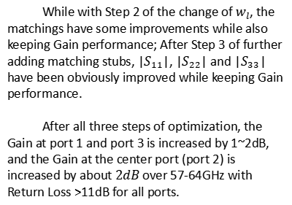
Optimization performance
04
While with Step 2 of the change of $w_{l}$, the matchings have some improvements while also keeping Gain performance; After Step 3 of further adding matching stubs, |$S_{11}$|, |$S_{22}$| and |$S_{33}$| have been obviously improved while keeping Gain performance.
After all three steps of optimization, the Gain at port 1 and port 3 is increased by 1~2dB, and the Gain at the center port (port 2) is increased by about $2dB$ over 57-64GHz with Return Loss >11dB for all ports.
(a)
(a)
(b)
(c)
Fig.7. S parameters performance: (a) |S11|, (b) |S22| and (c) |S33|.
(a)
(b)
(c)
Fig.8. Realized Gain performance: (a) P1 (b) P2 (c) P3.

Slide 11
Optimization performance
04
Fig.9 shows the patterns of three-port GAA after optimization at XZ plane.
When feeding at the edge at P1 and P3 this GAA works at traveling wave modes producing continuous frequency scanning beams over 57-64GHz, which enables fast scanning 2D radar imaging applications;
When feeding at the center at Port 2 this GAA works at resonant mode producing boresight beams over 57-64GHz, which enables 3D radar imaging applications.
(a)
(b)
(c)
Fig.9. Patterns at XZ plane after optimization: (a) P1 (b) P2 (c) P3.

Slide 12
Conclusion
05
The 60GHz three-port GAA in low-cost PCB technology has been designed and optimized. The optimization of the GAA radiator meshes includes changing the short side width to increase the Gain, changing the long side width to further slightly improve the matching, and adding matching stubs to finally improve impedance matching greatly while keeping Gain performance.
The optimized GAA has demonstrated the frequency scanning beams with 1~2dB Gain improvement when feeding at edge ports as well as boresight resonant beams with 2dB Gain improvement when feeding at the center port with Return Loss >11dB. These features enable three-port GAA to find usage in 2D and 3D multimood Radar im-aging applications.

Slide 13
References
[1] H. Nakano, T. Kawano, Y. Kozono, J. Yamauchi, “A fast MoM calculation technique using sinusoidal basis and testing functions for a wire on a dielectric substrate and its application to meander loop and grid array antennas,” IEEE Trans. Antennas Propagat., vol. 53, no. 10, pp. 3300-3307, October 2005.
[2] M. Sun and Y. P. Zhang, “A 60-GHz LTCC microstrip grid array antenna,” 2010 Asia-Pacific Microwave Conference, Yokohama, Japan, 2010, pp. 1673-1676.
[3] Z. Chen, Y. P. Zhang, A. Bisognin, D. Titz, F. Ferrero and C. Lux-ey, “A 94-GHz Dual-Polarized Microstrip Mesh Array Antenna in LTCC Technology,” in IEEE Antennas and Wireless Propagation Letters, vol. 15, pp. 634-637, 2016.
[4] Z. Chen and Z. Y. Ping, “24-GHz microstrip grid array antenna for automotive radars application,” 2015 IEEE 5th Asia-Pacific Con-ference on Synthetic Aperture Radar (APSAR), 2015, pp. 125-127.
[5] M. Sun, et al. “Antenna and method of forming the same,” US20200358205A1.
[6] R. Gopika and C. Saha, “Millimeter Wave Grid Array Antenna for Wireless Power Transmitter,” 2019 IEEE Recent Advances in Ge-oscience and Remote Sensing : Technologies, Standards and Ap-plications (TENGARSS), 2019, pp. 54-56.

Slide 14
Thanks for listening
Q&A

